Slide 1
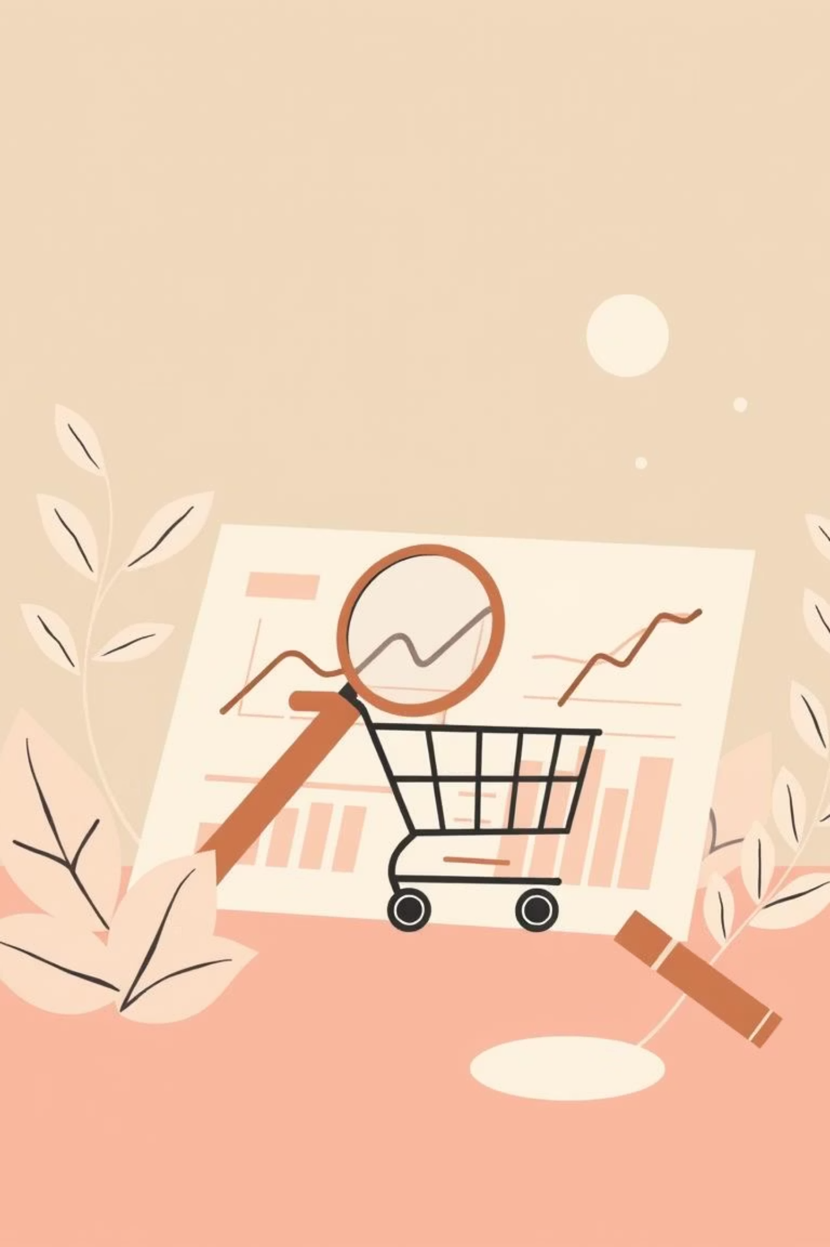
Customer Shopping Behavior Analysis
Uncovering insights from transactional data to guide strategic business decisions.

Slide 2
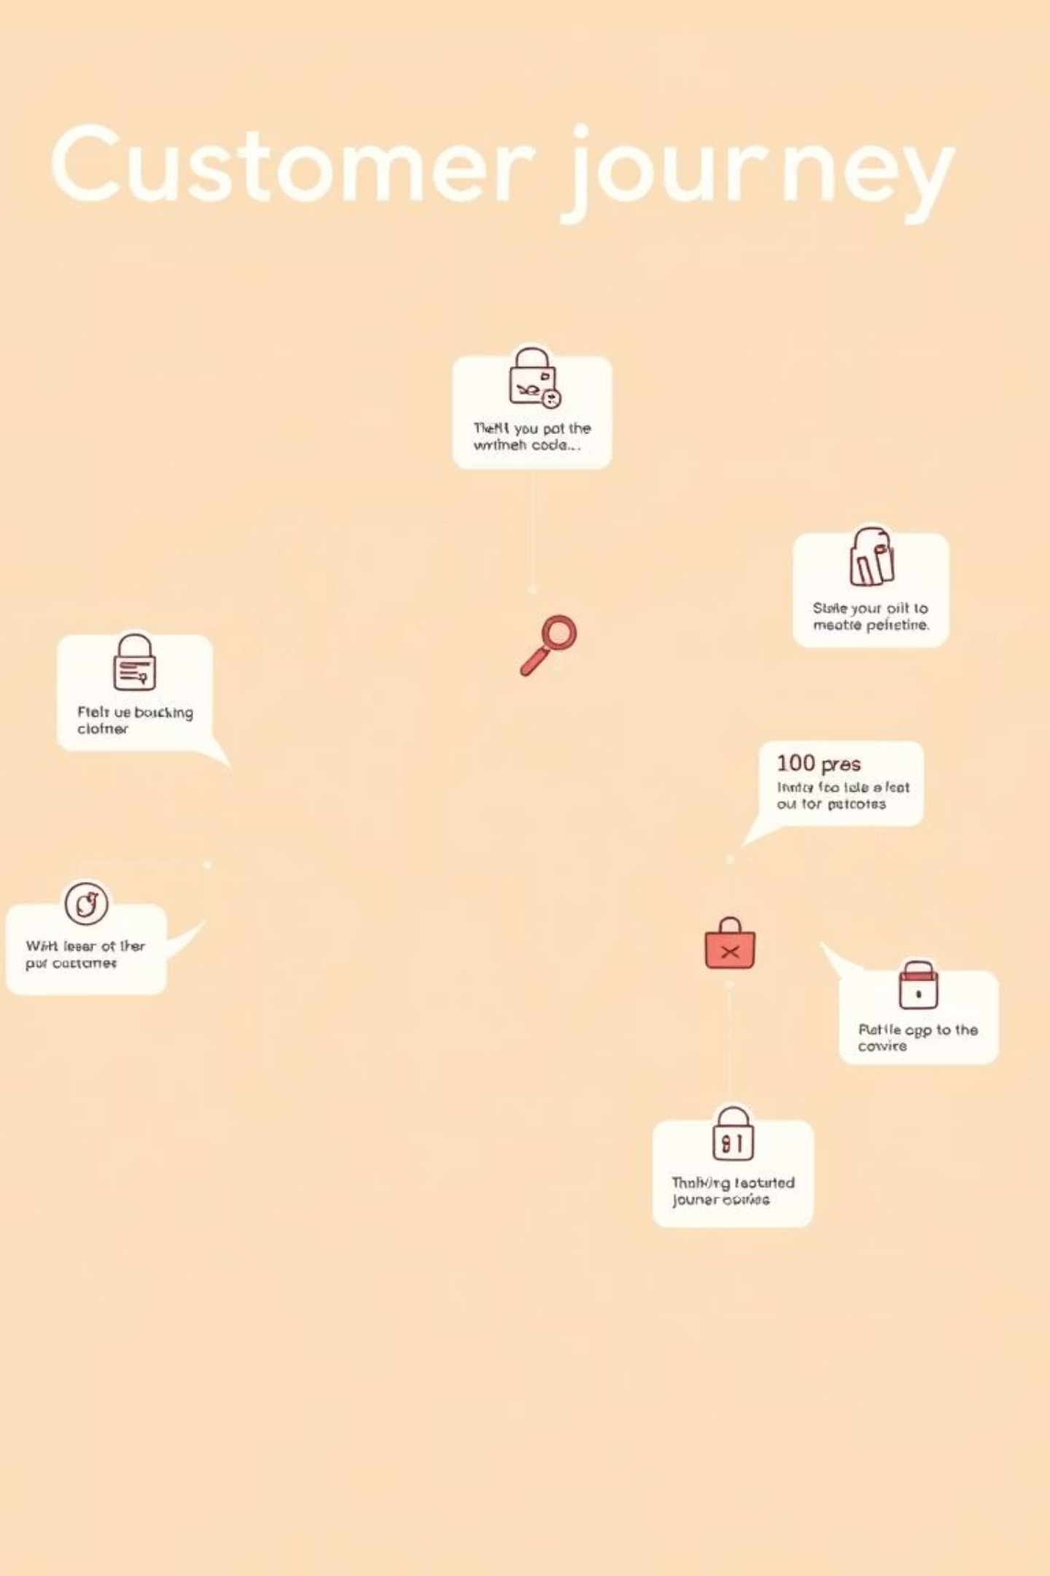
Project Overview
Goal
Analyze 3,900 purchases to understand spending patterns, segments, and preferences.
Objective
Optimize operations, reduce costs, and improve forecasting for future-proofing business.

Slide 3

Dataset Summary
Data Points
3,900 Rows, 18 Columns
Key Features
Demographics, Purchase Details, Shopping Behavior
Missing Data
37 values in Review Rating

Slide 4

Exploratory Data Analysis (Python)
01
Data Loading & Exploration
Imported with pandas, checked structure and summary statistics.
02
Missing Data Handling
Imputed Review Rating using median per category.
03
Feature Engineering
Created age_group and purchase_frequency_days.
04
Database Integration
Loaded cleaned data into PostgreSQL for SQL analysis.

Slide 5
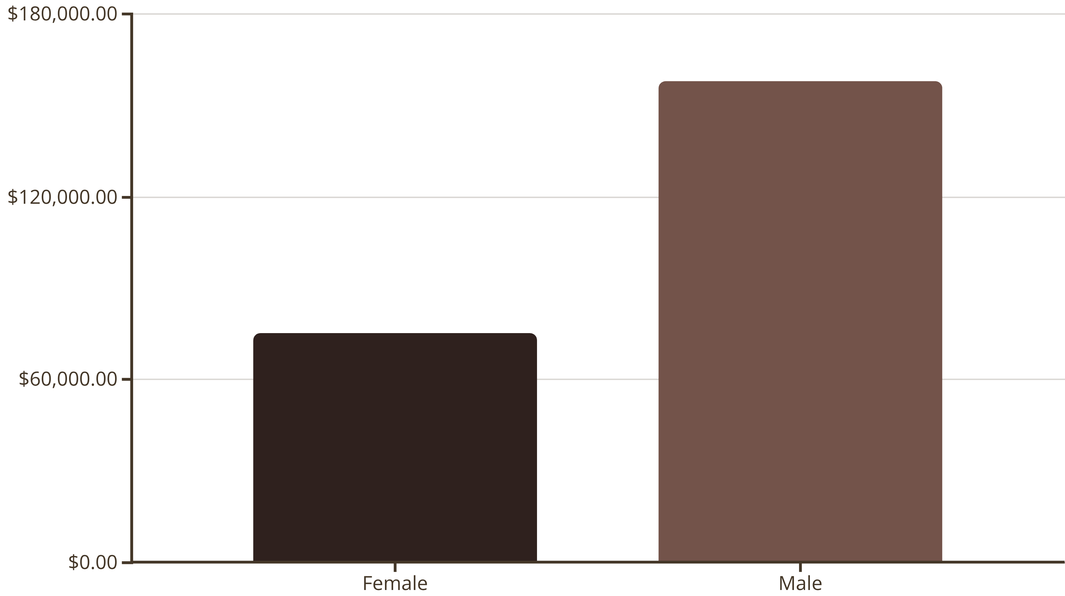
Revenue by Gender
Male customers generated significantly higher revenue than female customers.

Slide 6
Top 5 Products by Rating
Gloves
3.86
Sandals
3.84
Boots
3.82
Hat
3.80
Skirt
3.78
Gloves, Sandals, and Boots lead with the highest average review ratings.

Slide 7
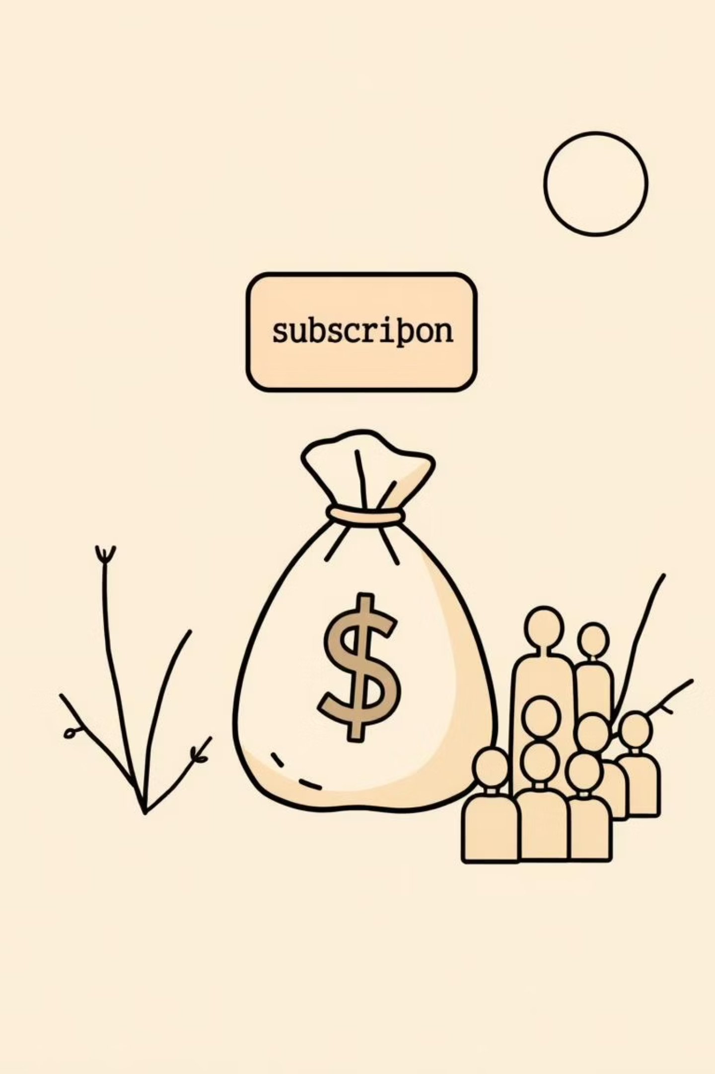

Subscribers vs. Non-Subscribers
Subscribers
1053 customers, Avg Spend: $59.49, Total Revenue: $62,645
Non-Subscribers
2847 customers, Avg Spend: $59.87, Total Revenue: $170,436
Non-subscribers contribute more to total revenue despite similar average spend.

Slide 8



Customer Segmentation
Returning
701 Customers
New
83 Customers
Loyal
3116 Customers
Majority of customers are loyal, indicating strong retention.

Slide 9
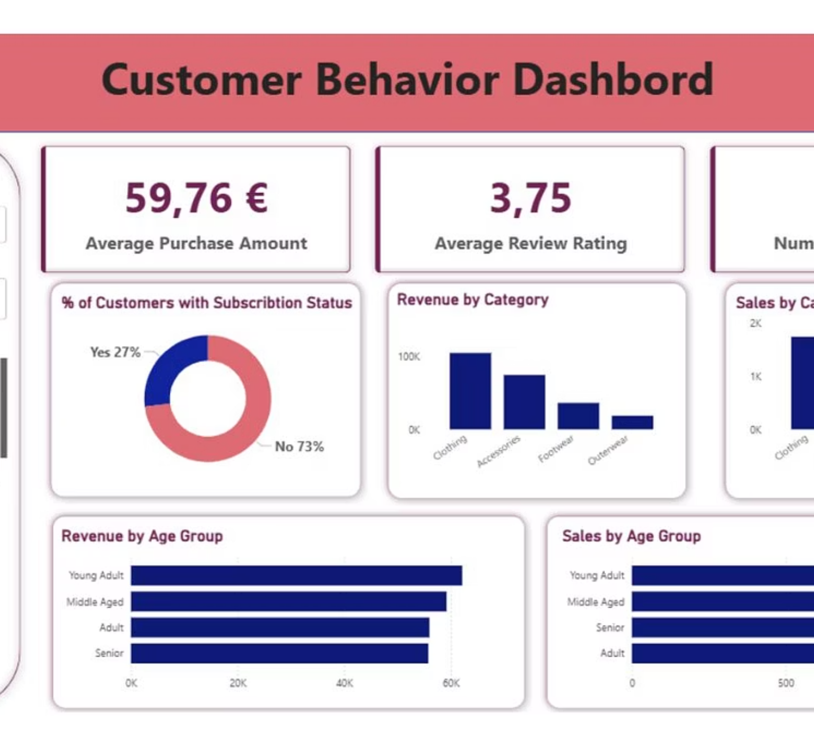
Dashboard in Power BI
Interactive dashboard for visual insights.
Visualizing key metrics and trends for informed decision-making.

Slide 10

Business Recommendations
Boost Subscriptions
Promote exclusive benefits to increase subscriber base.
Customer Loyalty Programs
Reward repeat buyers to foster loyalty and move them into the "Loyal" segment.
Targeted Marketing
Focus campaigns on high-revenue age groups and express-shipping users.
Product Positioning
Highlight top-rated and best-selling products in marketing efforts.

